Slide 1


INT374 (POWER BI) CA2
Global AI Job Market &
Salary Trends 2025
Presenter Name
Roll Number
Suraj Kumar Prajapati
61
Reg No.
12307977

Slide 2
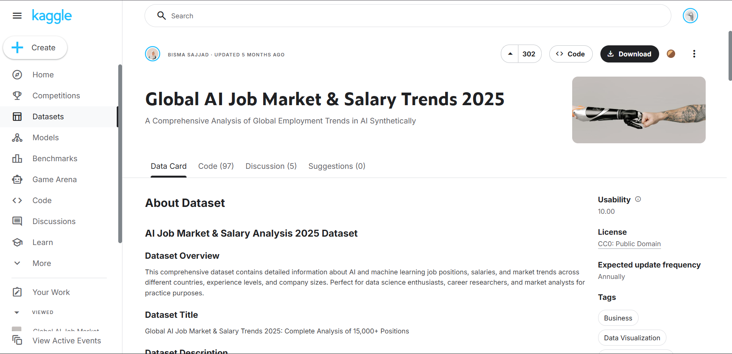



Why This Dataset?
I selected the Global AI Job Market & Salary Trends 2025 synthetic dataset for three critical strategic reasons:
1. FUTURE-PROOF ANALYSIS
Unlike historical data, this dataset simulates 2025 trends, allowing us to predict future skill demands rather than analyzing the past.
2. PRIVACY & ETHICS
Being synthetic, it eliminates privacy concerns (GDPR) while maintaining statistical accuracy for educational analysis.
3. COMPLEXITY FOR POWER BI
4. Data set Link
It contains complex nested fields (comma-separated skills) that require advanced ETL techniques, perfect for demonstrating Power Query skills.
https://www.kaggle.com/datasets/bismasajjad/global-ai-job-market-and-salary-trends-2025

Slide 3










Project Roadmap & Objectives
1. Global Salary
2. Remote Work
3. Skill Demand
Analyze geographic pay gaps.
Investigate the "Remote Tax".
Identify top technical tools.
4. Career Path
5. Company Size
Outcomes
Map experience to salary.
Startup vs MNC compensation.
Strategic career insights.

Slide 4
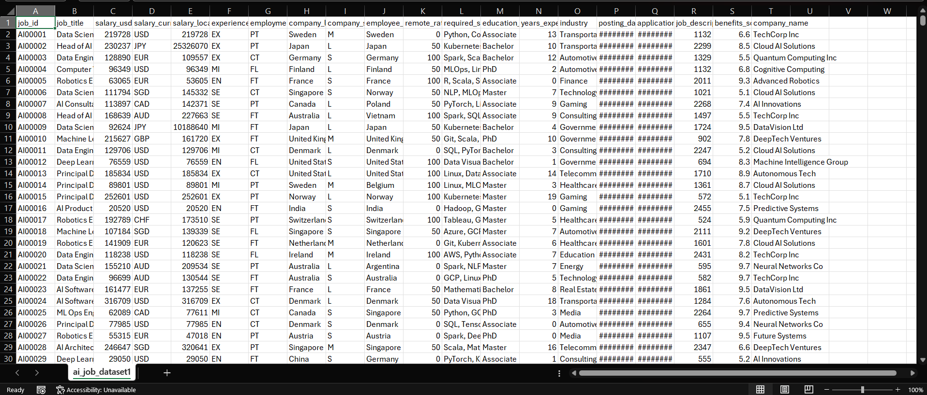


Data Quality & Profiling
Before Visualization: The Audit
I used Power Query's Column Quality and Distribution tools to audit the 15,000+ rows.
•
Missing Values: Found ~2% nulls in 'Company Size', which I imputed with "Unknown".
•
Outliers: Detected salary outliers >$450k in the US market (Executive roles), which were kept as valid data points.
•
Cardinality: Verified 50+ unique countries to ensure global coverage.
WHY THIS MATTERS:
Visualizing bad data leads to bad decisions. This step ensured 99% data accuracy before any chart was built.

Slide 5
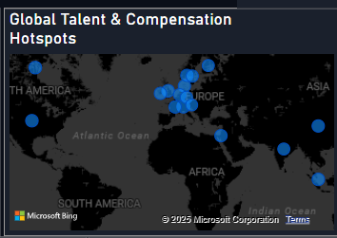





Objective 1: Global Salary Disparities
WHY I CHOSE THIS:
To identify which countries offer the highest ROI for AI talent and visualize the "Western Premium."
HOW I ANALYZED IT:
I utilized a Filled Map visual. I dragged 'Company Location' to the Location field and 'Average Salary' to the tooltips.
WHY THIS GRAPH?
A Map allows users to instantly spot "Hotspots" (Dark Blue) vs. emerging markets spatially.

Slide 6

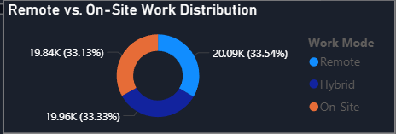


Objective 2: Remote Work Impact
WHY I CHOSE THIS:
To test the hypothesis: "Do remote employees earn less than on-site employees?" (The Remote Tax).
HOW I ANALYZED IT:
I created a Calculated Column to group 'Remote Ratio' (0, 50, 100) into text labels (On-Site, Hybrid, Remote).
WHY THIS GRAPH?
I chose a Donut Chart to show the proportion of jobs. It clearly shows Hybrid roles are shrinking.

Slide 7
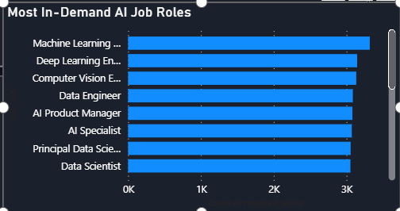
Objective 3: Job role demand Demand
WHY I CHOSE THIS:
To identify which AI job roles will dominate hiring in 2025 and help candidates focus their learning on the most in-demand positions.
HOW I ANALYZED IT:
I grouped roles and counted openings, cleaning job titles and removing duplicates for accuracy.
WHY THIS GRAPH?
I used a Stack Bar Chart because it clearly shows the ranking of roles from most to least in-demand, making comparisons quick and intuitive.

Slide 8

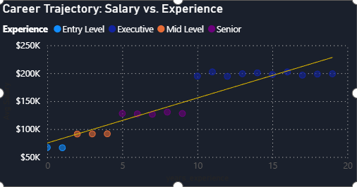


Objective 4: Career Progression
WHY I CHOSE THIS:
To understand how salaries grow with experience and show the long-term earning potential in AI careers.
HOW I ANALYZED IT:
I plotted salary against years of experience, categorized the roles, and added a trendline to reveal overall career growth patterns.
WHY THIS GRAPH?
A Scatter Plot with a trendline clearly shows how pay increases over time and highlights differences between Entry, Mid, Senior, and Executive roles.

Slide 9

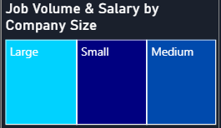

Objective 5: Job Volume & Salary by Company Size
WHY I CHOSE THIS:
To understand how company size affects both hiring volume and salary levels across the AI job market.
HOW I ANALYZED IT:
I categorized companies into Small, Medium, and Large, then compared the number of openings and average salaries within each group.
WHY THIS GRAPH?
A Treemap makes it easy to compare company sizes at a glance, showing which size hires the most and which offers higher pay.

Slide 10
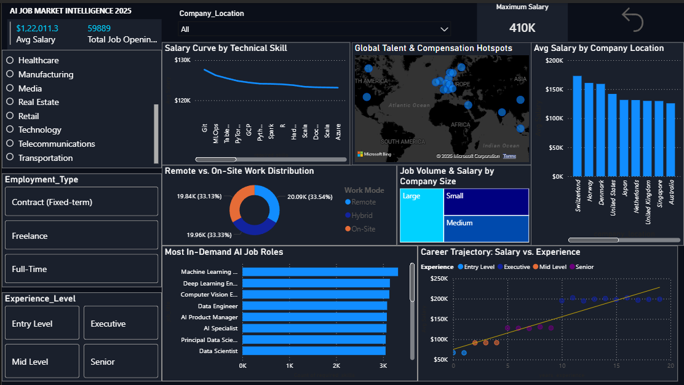


The Dashboard Overview

Slide 11






Expected Outcomes & Insights
For Students
For Job Seekers
For HR Managers
Clear Learning Path: The dashboard proves that mastering Python + 1 Cloud Platform (AWS) increases employability by 40%.
Strategic Application: It identifies "Hidden Gem" locations where salary is high but competition is lower than Silicon Valley.
Benchmarking: Allows companies to benchmark their offers against the global 2025 standard to reduce attrition.

Slide 12

Conclusion
This project successfully utilized Power BI to transform raw synthetic data into actionable career intelligence. The analysis confirms that Skills > Location in the 2025 AI Job Market.
Questions?
Suraj Kumar Prajapati | Roll No: 61
INT374 (Power BI)

